Slide 1
Computer System and Networking LAB
[CSA]
BATTLESHIP
GROUP 1
FINAL PROJECT #CSA | BATTLESHIP
Date_
23/11/2022
Reynard Pradhitya - 21/472680/PA/20321
Reza Aurelio Brilliansah - 21/475039/PA/20515
Ahmad Fadhil Bukhori - 21/475083/PA/20525

Slide 2
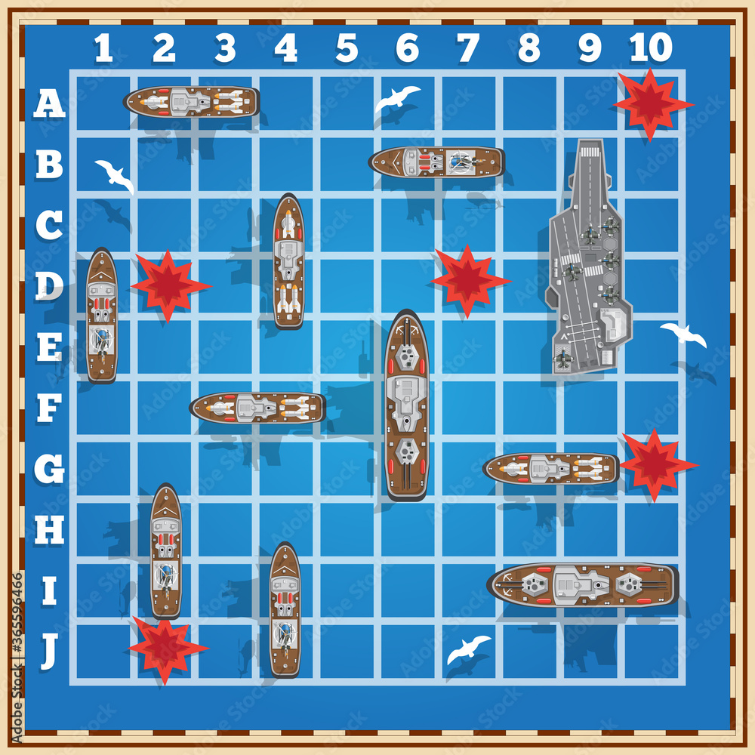
PROJECT BATTLESHIP
Battleship is already widely known by people an the rules are considered quite simple. We believe that most of us are already familiar with this game. We want our project to be enjoyed by people in general. That is why we chose battleship to be the main theme of our project.
FINAL PROJECT #CSA | BATTLESHIP
0‹#›

Slide 3
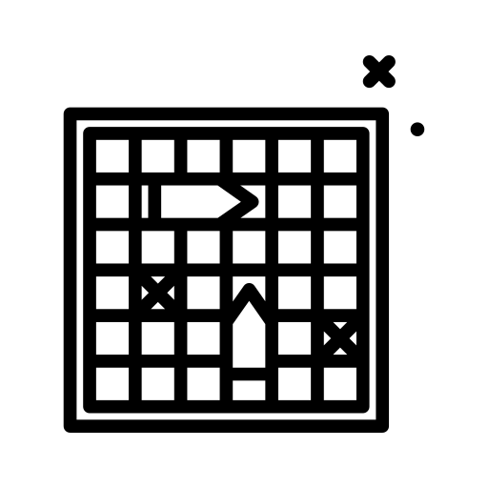

The main goal of our project is to recreate the Battleship board game using socket programming. The objective of the game is to sink the enemy’s battleships before they sink yours by inputting the correct coordinates of the enemy ships.
This program allows a player to create a battleship game server so that another player could join the game as a client by using the correct IP. The boards for the battleships are printed to the console and locations of the battleships are randomized.
FINAL PROJECT #CSA | BATTLESHIP
0‹#›

Slide 4
HOW DOES IT WORK
Player 1 starts the server and hosts a game, and player 2 establishes a connection to the server
The program randomizes the locations of the battleships based on how many battleships are selected and displays them on the grid displaying their own grid. At the start, the enemy board grid is empty
When a player’s board has no more battleships remaining, the user is presented with a ‘defeat’ screen. A player that has a score equal to the amount of boats will display a ‘victory’ screen
01
02
03
04
05
The program creates two grids for each player, one for their own board, and one for the enemy board
Players take turns guessing the locations of the enemy battleships by inputting coordinates until one side has no battleships remaining. When a ship is hit, the number of boats for that player decreases while the attacking player increases his score
FINAL PROJECT #CSA | BATTLESHIP
0‹#›

Slide 5
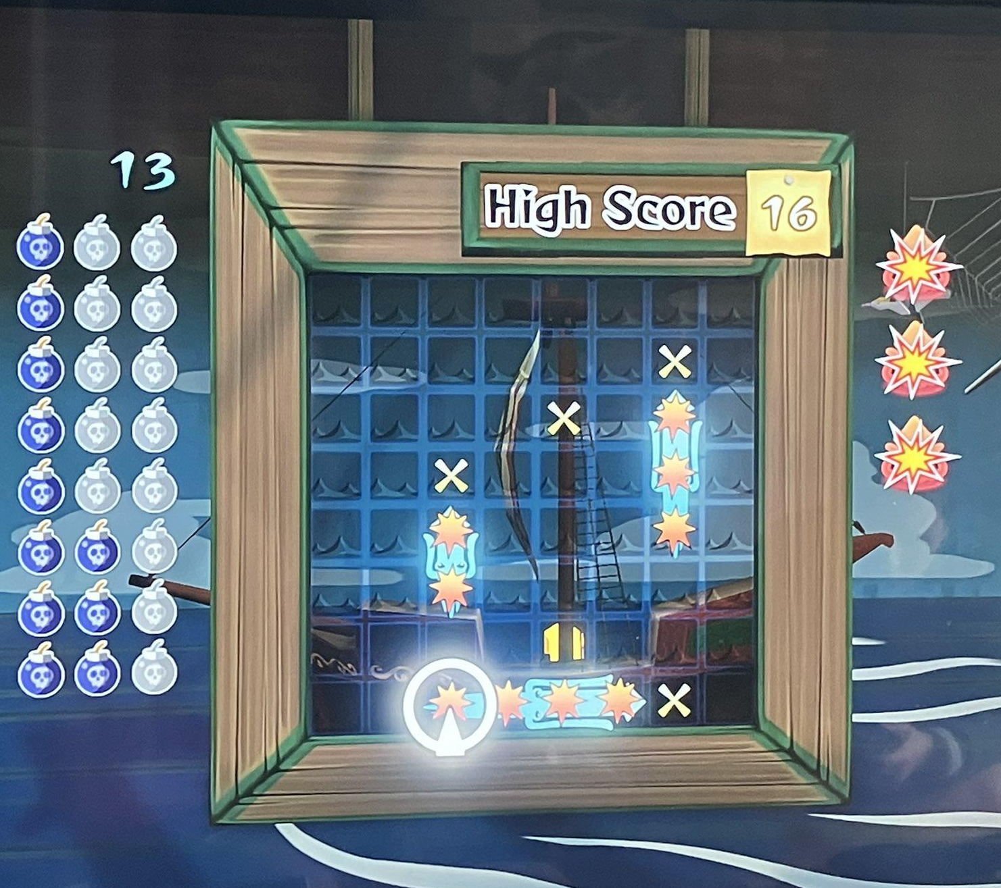
INSPIRATIONS
We are aware that Battleship is a very popular game and there are a lot of people who have coded their own versions of battleships.
Our main reference was:
https://github.com/AndreiGhenoiu/Java-Battleships
As the general mechanic mimics the real game, there are many similarities to other versions available online, but we made sure that our program is purely made from scratch (No ctrl c ctrl v)
FINAL PROJECT #CSA | BATTLESHIP
0‹#›

Slide 6
OUR OWN MODIFICATIONS
01
02
03
04
Boats are randomly generated by the program instead of the player inputting the location of the ships
We use our own logic to implement checking if a coordinate is a hit as the player board used a matrix of boolean values
Different turn based system between players and IP usage for device-to-device connection in receiving and sending messages
Modified the losing condition from checking the board for remaining ships to keeping track of the number of ships alive
FINAL PROJECT #CSA | BATTLESHIP
0‹#›

Slide 7
00!
BATTLESHIP
CODE
SCREENSHOT
BRIEF EXPLANATION
Date_
23/11/2022
FINAL PROJECT #CSA | BATTLESHIP
0‹#›

Slide 8
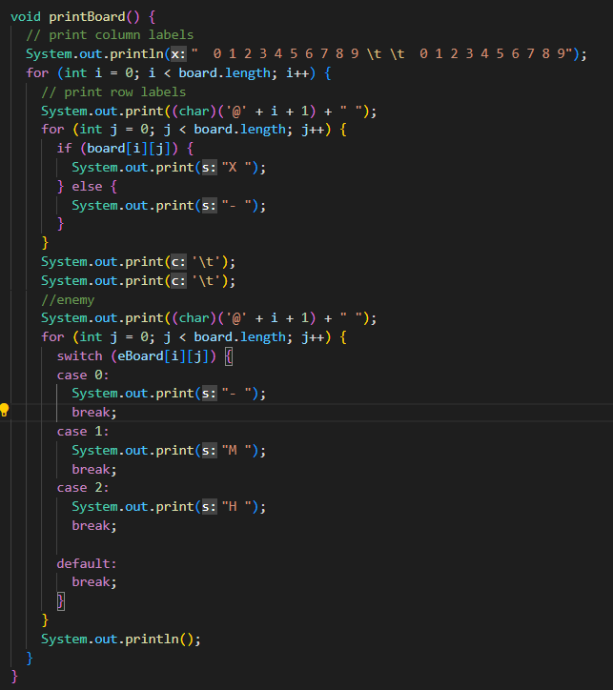
CODE EXPLANATIONS
Print Player Board using a simple for loop. We used an if statement to check if there is a boat
Print Enemy Board using a for loop at the side of the player board. We used a switch to print a hit, miss, or untouched
FINAL PROJECT #CSA | BATTLESHIP
0‹#›

Slide 9
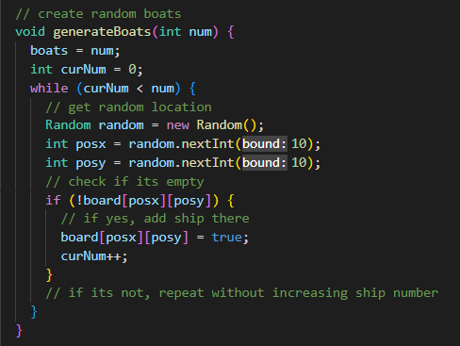
CODE EXPLANATIONS
Randomized the ships location by generating random numbers for x and y axis. We made sure that the boats are not in the same place
FINAL PROJECT #CSA | BATTLESHIP
0‹#›

Slide 10
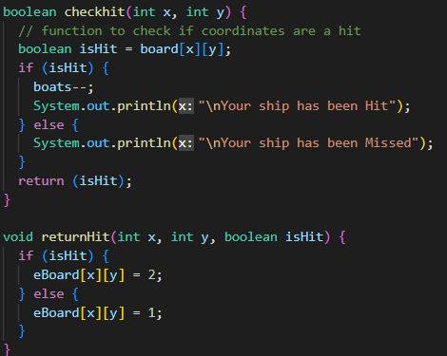
CODE EXPLANATIONS
Check if enemy coordinates are a hit . Since the boat locations are stored in a boolean matrix, we can check the truth value of the coordinates
Modify the enemy board matrix based on whether our coordinates are a hit or not
FINAL PROJECT #CSA | BATTLESHIP
0‹#›

Slide 11
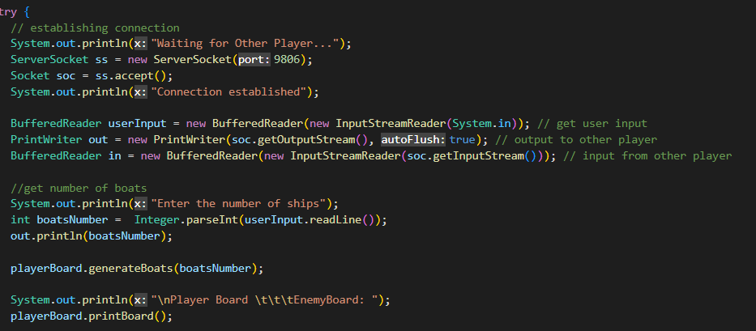
CODE EXPLANATIONS
Creating a connection by opening a server socket. We also made a buffered readers and print writers to communicate with the other client
Inputting number of ships and then sending it to the client. Then generate the player board.
FINAL PROJECT #CSA | BATTLESHIP
0‹#›

Slide 12
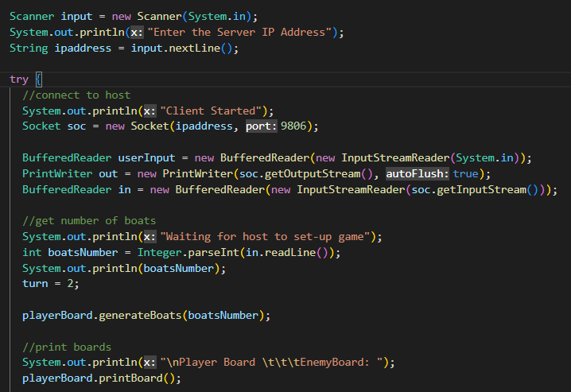
CODE EXPLANATIONS
Connecting with the host by inputting their IP address.
The client receives a message from the server containing the amount of boats. The client parses it into a string and generates the required boats
FINAL PROJECT #CSA | BATTLESHIP
0‹#›

Slide 13
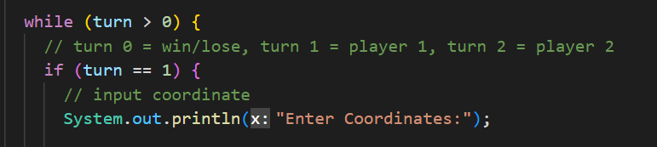
CODE EXPLANATIONS
The program runs in a while loop that is true as long as the turn is over 0. When turn = 1, the player attacks, and when the turn=2, the player receives an attack. When the game ends, the score is set to 0, ending the loop. The host is set to always have the first turn
FINAL PROJECT #CSA | BATTLESHIP
0‹#›

Slide 14
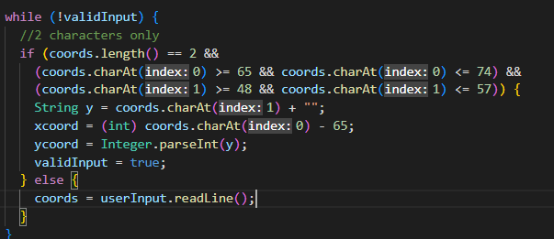
CODE EXPLANATIONS
Checking the input value whether it is valid or not by checking the coordinates value
FINAL PROJECT #CSA | BATTLESHIP
0‹#›

Slide 15
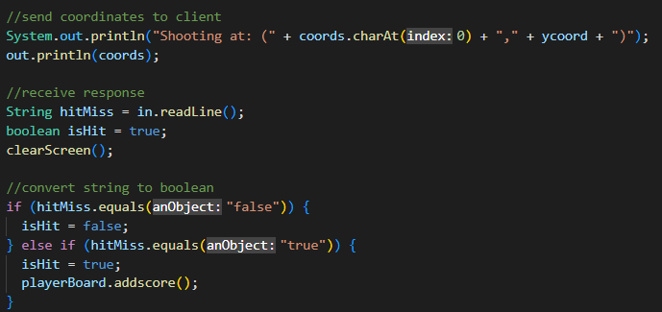
CODE EXPLANATIONS
Output the coordinates to the other player and wait for a response containing hit or miss, then convert the message to a boolean
FINAL PROJECT #CSA | BATTLESHIP
0‹#›

Slide 16
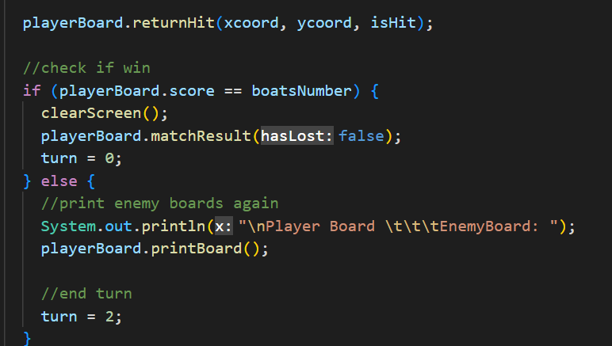
CODE EXPLANATIONS
Using the returnHit function we update the enemy board with a hit or miss on the coordinate. Then we check for our win condition, and if so, we show the victory match result. Otherwise, we pass the turn
FINAL PROJECT #CSA | BATTLESHIP
0‹#›

Slide 17
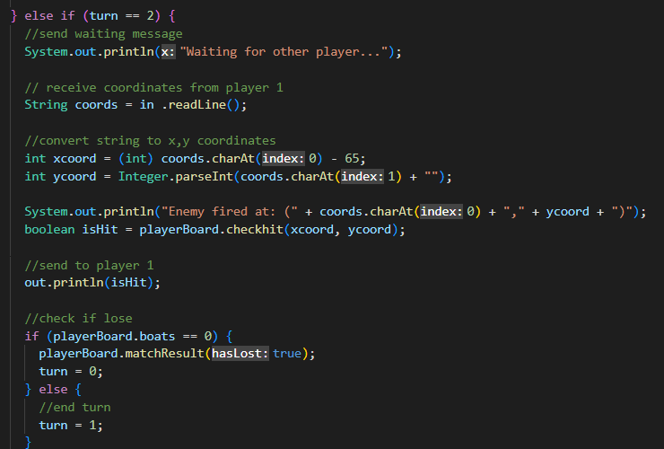
CODE EXPLANATIONS
This part shows the receiving attack part. We receive the coordinates from the other player. We extract the first character and convert the character into an integer and we parse the second character which is a number. Then check if it is a hit and miss. Then we send this to the other player
Check if we have any boats remaining, if we don’t then it is the player’s defeat, otherwise, pass the turn
FINAL PROJECT #CSA | BATTLESHIP
0‹#›

Slide 18
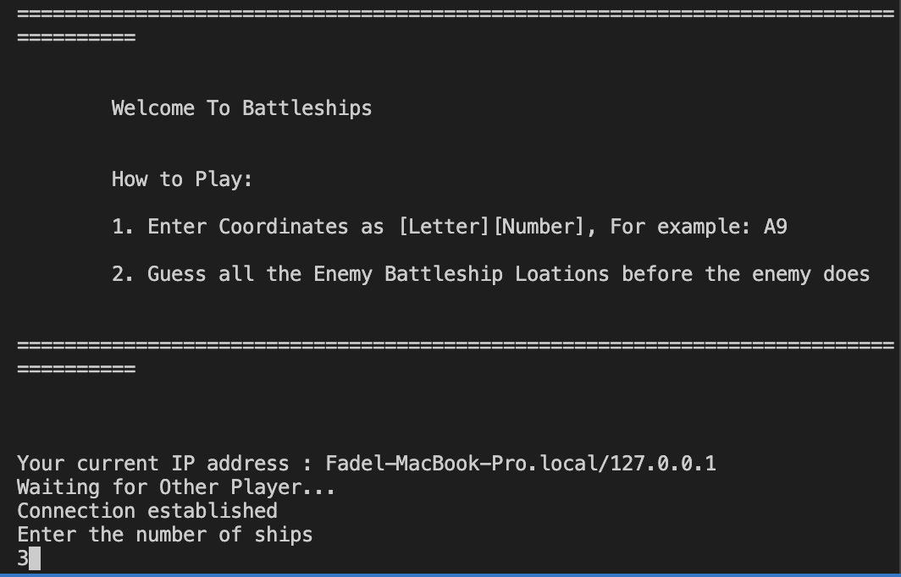
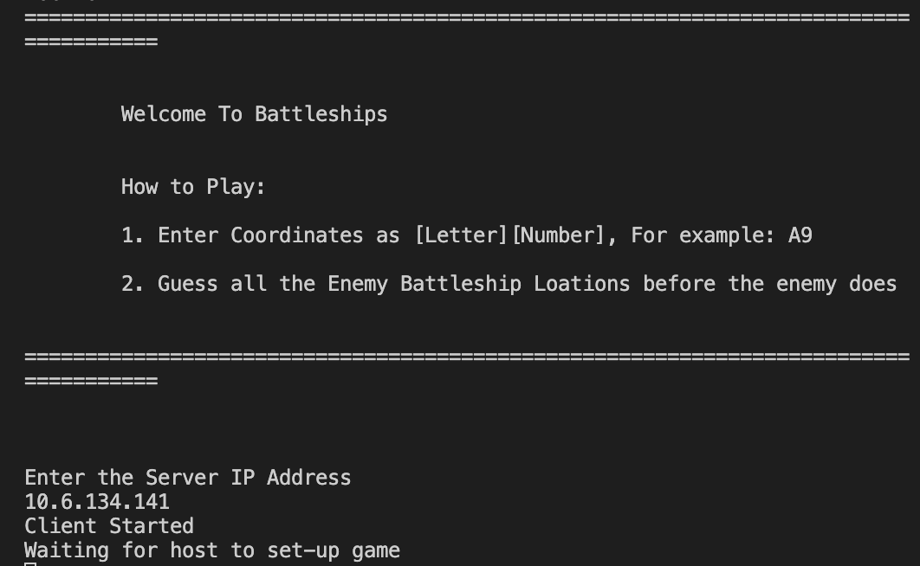
RUNNING THE CODE
FINAL PROJECT #CSA | BATTLESHIP
0‹#›

Slide 19
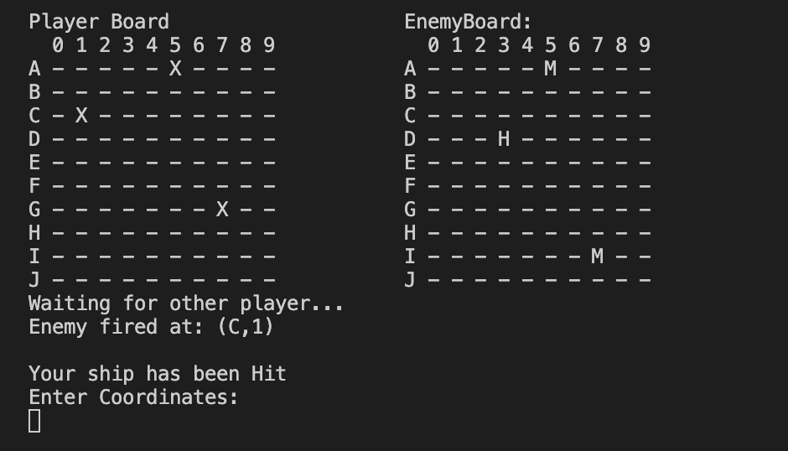
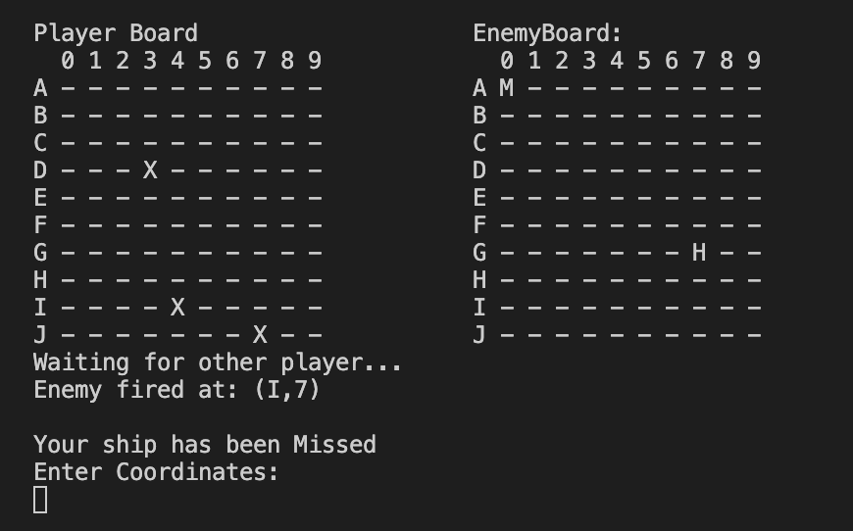
RUNNING THE CODE
FINAL PROJECT #CSA | BATTLESHIP
0‹#›

Slide 20
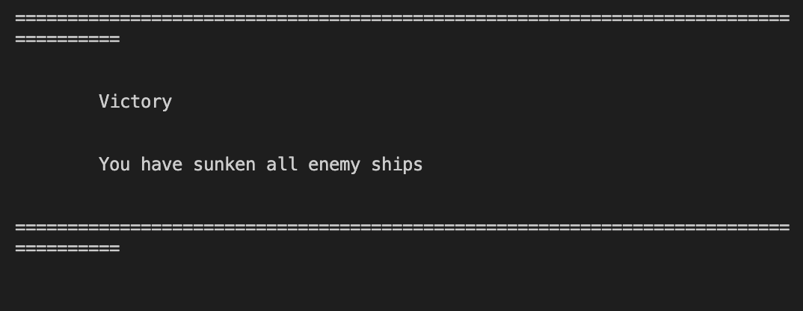
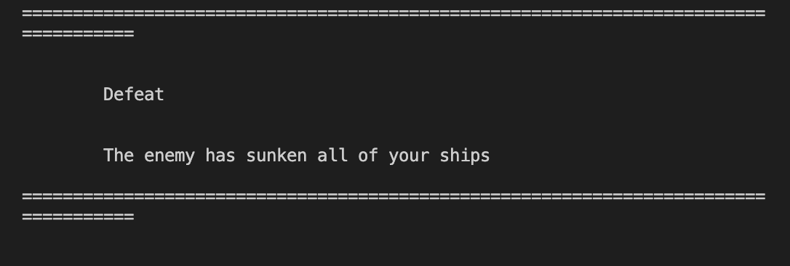
RUNNING THE CODE
FINAL PROJECT #CSA | BATTLESHIP
0‹#›

Slide 21

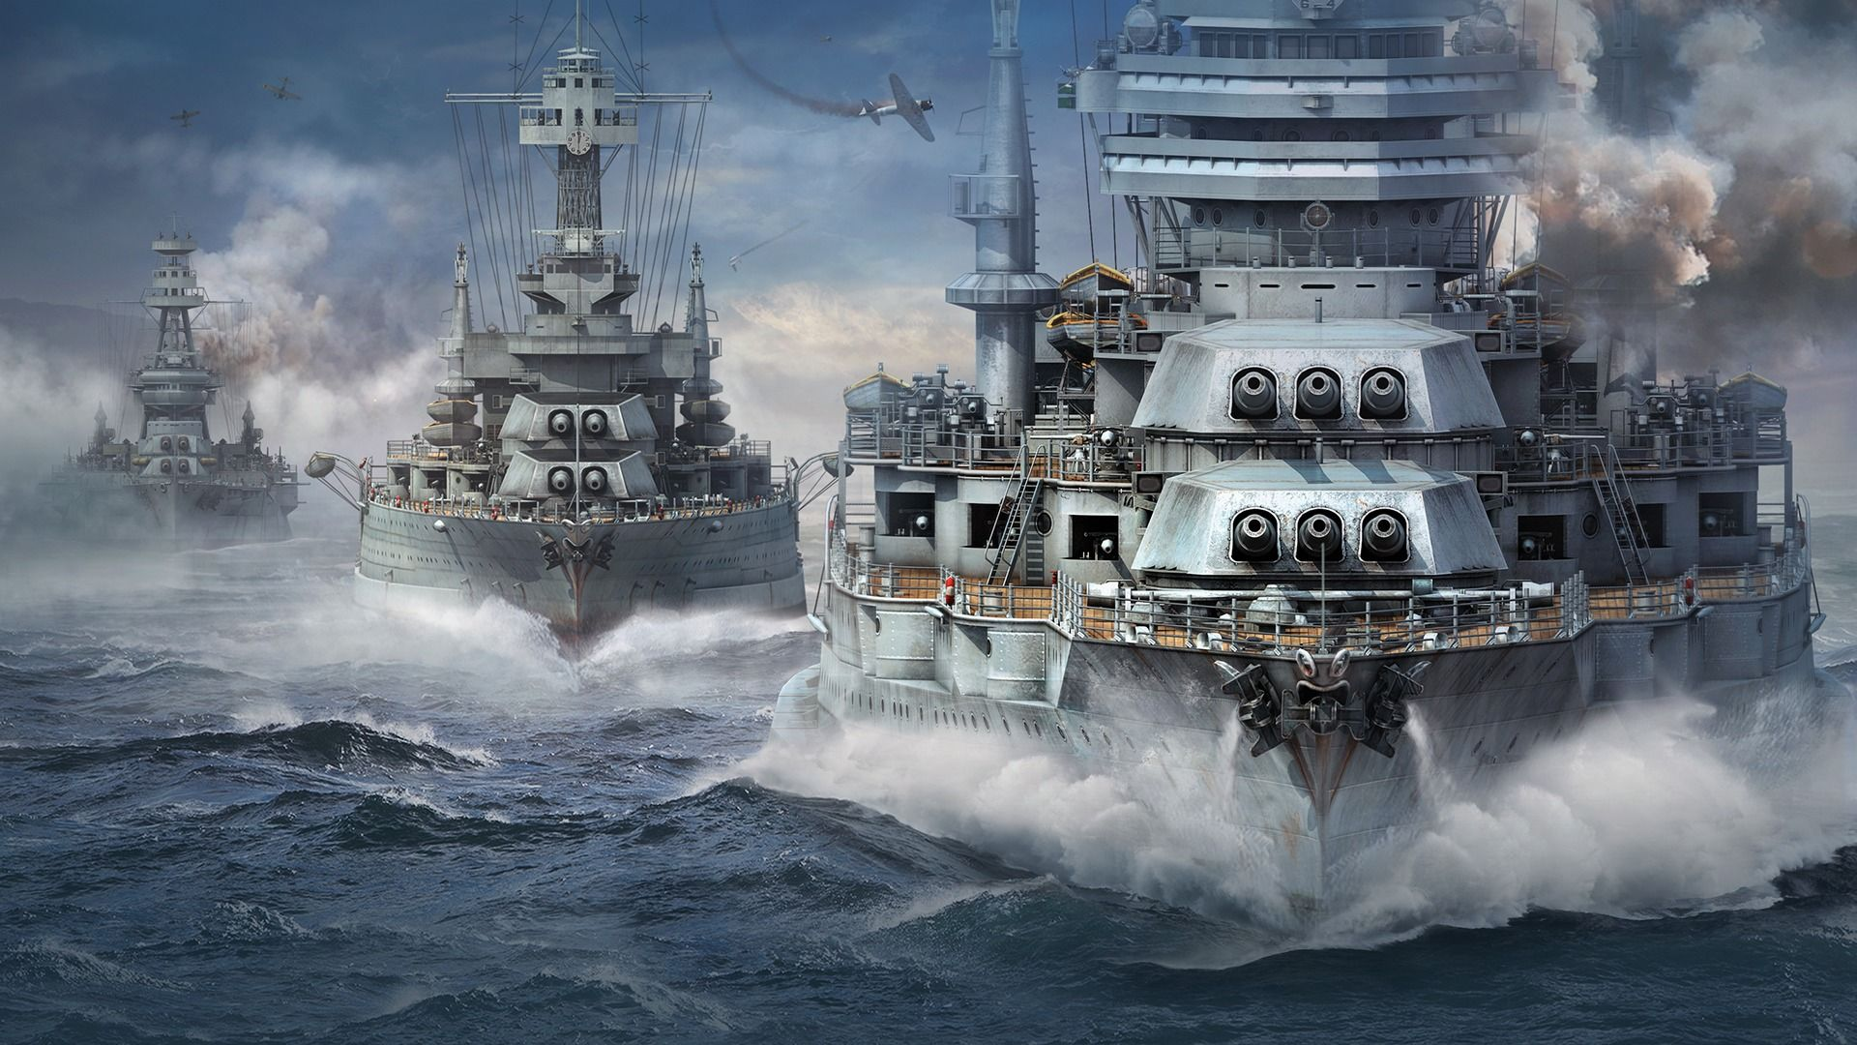
THANKS !

